Slide 1
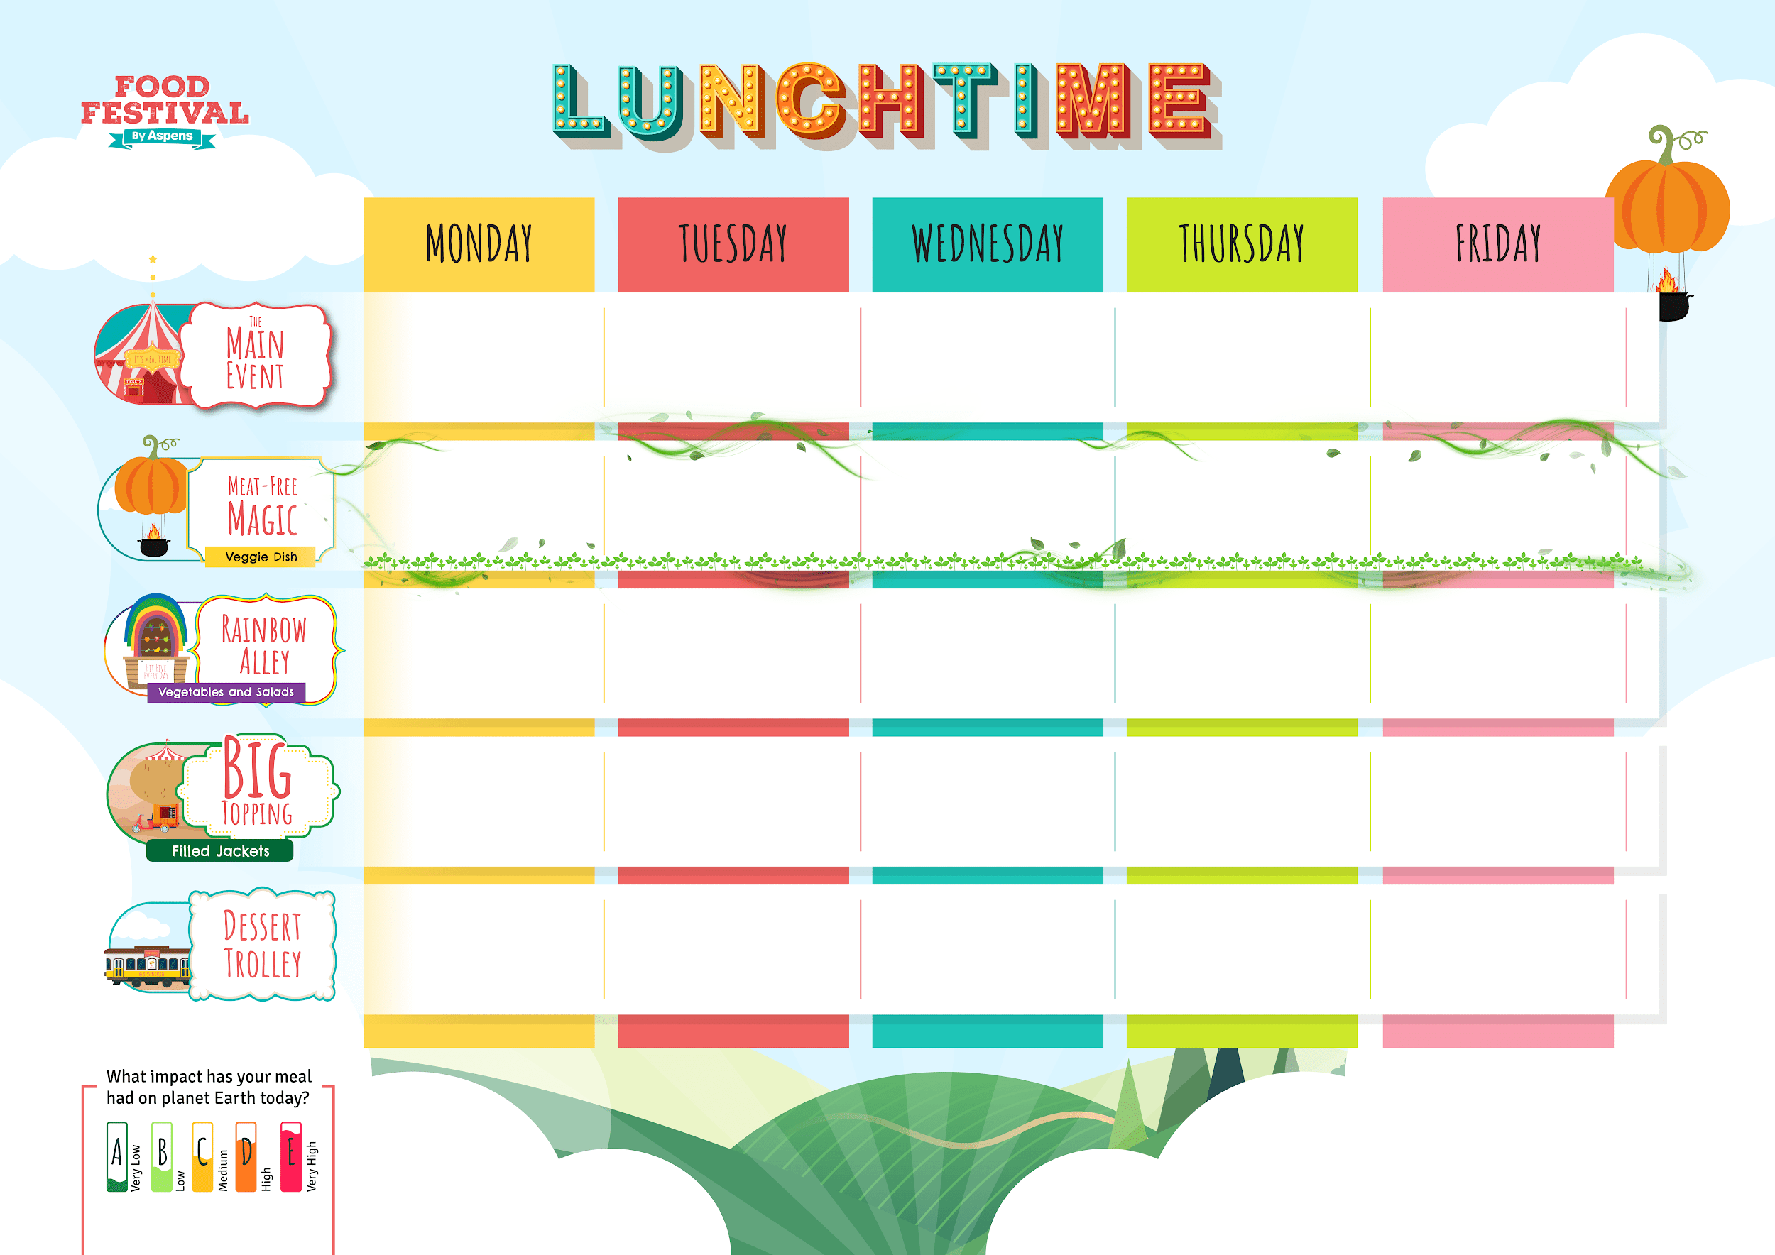












PRIMARY
WORLD
WEEK 1
Autumn Winter 2025/26
*Dates to be entered by RO managers, as start dates vary by unit
Cheese and Tomato Pizza Slice
with Wedges
Sweet Chilli
Chicken Noodles
Roast Chicken, Stuffing, Skin on Roasties
and Gravy
Moroccan Meatball Tagine and Rice
Golden Fish Fingers
or
Salmon Fingers
and Chips
Baked Sweetcorn Fritters
with Wedges
Hoisin Sticky
Vegetable Noodles
Roasted Vegetable Strudel, Skin on Roasties and Gravy
Sweet Potato Tagine
and Rice
Cheesy Bean Wrap
with Chips
Vegetable Sticks
Green Beans
Carrots and Cabbage
Mixed Greens
Peas
Beans,
Cheese or
Tuna Mayo
Beans,
Cheese or
Tuna Mayo
Beans,
Cheese or
Tuna Mayo
Beans,
Cheese or
Tuna Mayo
Beans,
Cheese or
Tuna Mayo
Butterfly Pastry Biscuits
Strawberry and Pineapple Jelly
Banana Bread
and Custard
Apple Cinnamon Buns
Lemon Drizzle Cake
Topped Pasta
Daily salad bowl, freshly baked bread, yoghurts and cut fruit
Hot Pasta topped with Homemade Tomato Sauce
& Cheese

Slide 2
PRIMARY
WORLD
WEEK 2
Autumn Winter 2025/26
*Dates to be entered by RO managers, as start dates vary by unit
Vegetable
Lasagne
Chicken Jambalaya
Roast Gammon,
Skin on Roasties
and Gravy
Spanish Chicken Stew with Potatoes and Tomato Sauce
Golden Fish Fingers
and Chips
Green Veg and Butter Bean Pie
with Wedges
Veggie Enchiladas
with Rice
Cheddar and Broccoli Crustless Quiche
Spanish Spinach and Chickpeas with
Potatoes and Tomato Sauce
BBQ Veggie Wrap
with Chips
Sweetcorn
Broccoli
Carrots and Peas
Mixed Greens
Baked Beans
Beans,
Cheese or
Tuna Mayo
Beans,
Cheese or
Tuna Mayo
Beans,
Cheese or
Tuna Mayo
Beans,
Cheese or
Tuna Mayo
Beans,
Cheese or
Tuna Mayo
Chocolate
Popcorn Bars
Orange and Peach Jelly
Apple Tea Cake
and Custard
Iced Vanilla
Sponge Cake
Carrot Cake
Topped Pasta
Daily salad bowl, freshly baked bread, yoghurts and cut fruit
Hot Pasta topped with Homemade Tomato Sauce
& Cheese

Slide 3
PRIMARY
WORLD
WEEK 3
Autumn Winter 2025/26
*Dates to be entered by RO managers, as start dates vary by unit
Cheese and Tomato Pizza Slice
with Wedges
Mild Chicken Tikka Masala and Rice
Roast Pork,
Skin on Roasties
and Gravy
Chicken Rasta Pasta
Golden Fish Fingers
and Chips
Macaroni Cheese
Tarka Dhal
Carrot and Stuffing Puff Pastry Plait,
Skin on Roasties
with Gravy
Sweet Potato Coconut Bean Stew
with Rice
Vegetable Fingers
with Chips
Vegetable Sticks
Carrots and
Green Beans
Roasted Roots
Sweetcorn
Baked Beans
Beans,
Cheese or
Tuna Mayo
Beans,
Cheese or
Tuna Mayo
Beans,
Cheese or
Tuna Mayo
Beans,
Cheese or
Tuna Mayo
Beans,
Cheese or
Tuna Mayo
Sweet Potato Chocolate Brownie
Jelly
Eve’s Apple Pudding
and Custard
Muesli Bars
Vanilla Cookies
Topped Pasta
Daily salad bowl, freshly baked bread, yoghurts and cut fruit
Hot Pasta topped with Homemade Tomato Sauce
& Cheese

